Slide 1
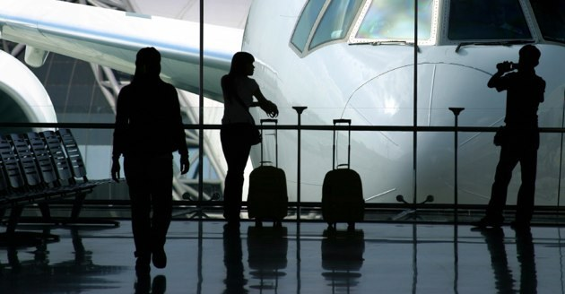
Analyzing Airline Data
INFO 290T – Working with Open Data – Fall 2014
Divya Menghani, Rahul Verma, Dheera Prabhakar

Slide 2
Introduction
As a group, we share common love for air-travel and curiosity about the airline industry. The recent missing Malaysian airline plane related incident spurred our interest further and made us realize how little we know about airlines, their schedules and their function in general. We began researching and stumbled upon US DoT dataset on their website, which looked pretty exhaustive and promising.
The United States Department of Transportation tracks the on-time performance of domestic flights operated by large air carriers. Various airlines have been contributing to the US DoT by sharing their yearly flight data with the U.S. DoT since 1987. The U.S. Department of Transportation publishes a monthly summary of airline on-time performance, including causes of delay, in the Air Travel Consumer Report along with an annual reports on variety of on-time and flight delay data so that the public would have clear information about the nature and sources of airline delays and cancellations.
DoT maintains each year’s data in the form of CSV files. Each file contains on-time arrival data for non-stop domestic flights by major air carriers, and provides such additional items as departure and arrival delays, origin and destination airports, flight numbers, scheduled and actual departure and arrival times, cancelled or diverted flights, taxi-out and taxi-in times, air time, and non-stop distance.
By exploring this dataset, we wanted to understand delay trends in the US airline industry. We planned to find out the most important/popular carriers in the country, evaluate their performance - about delays and the causes for the delays, what cities they affect. Our intent was to unravel some interesting trends in the last few years in the US airline industry with the help of data visualizations.

Slide 3
Problem Statement
Our analyses include to find patterns and analyze -
Delays by Airport
Delays by Carrier
Delays by Route
Delays by age of the plane
Delays by Day of Time
Delays by Day of Week
Delays by Day of Month
Busiest airports
Airline route density
Top airline routes

Slide 4
Dataset
Download airline on time data from http://stat-computing.org/dataexpo/2009/the-data.html.
Download supplemental data (airports, carriers, plane-data) from http://stat-computing.org/dataexpo/2009/supplemental-data.html.

Slide 5
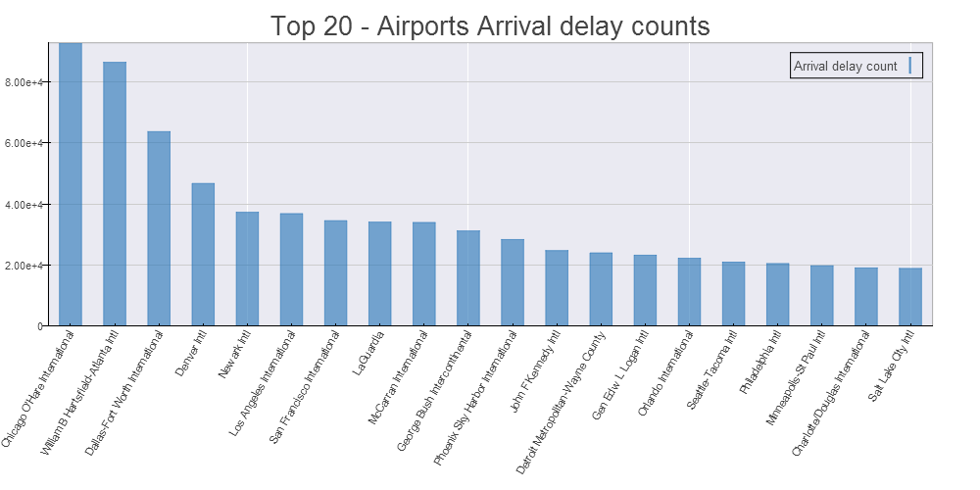
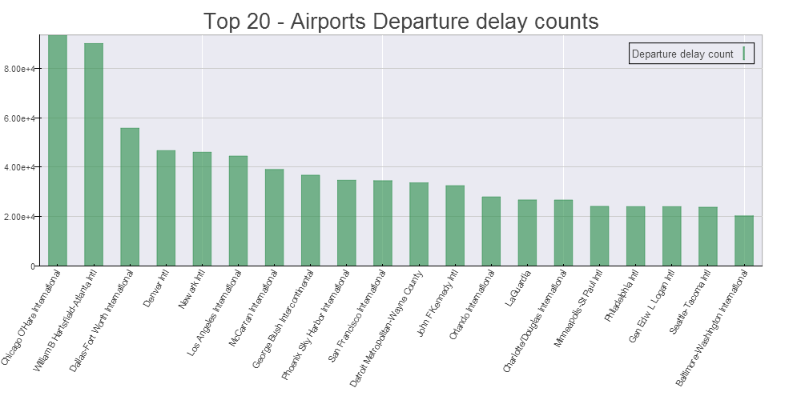
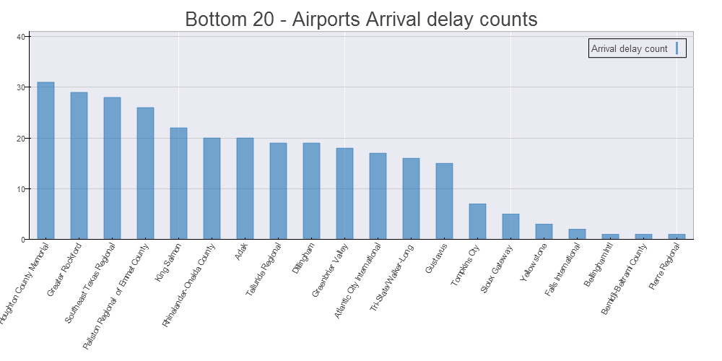
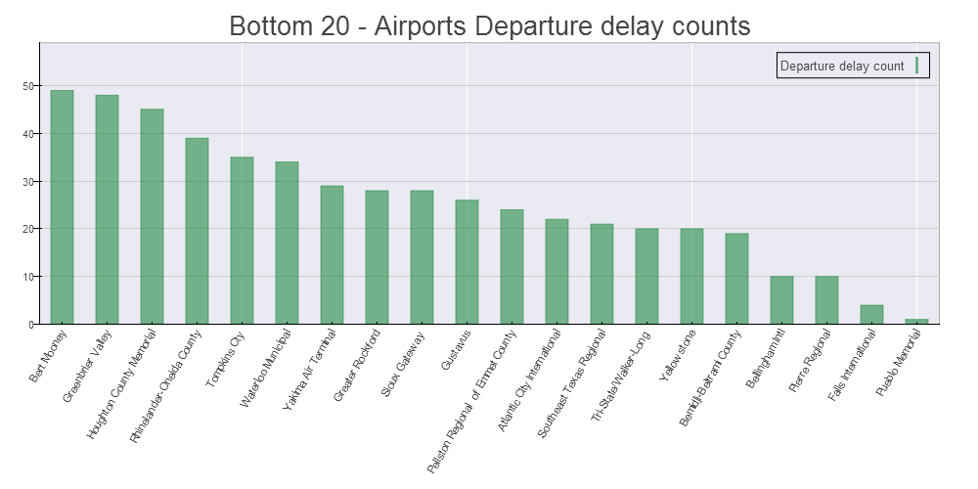
Delay Counts by Airport
Here we analyze the delays by airports.
Inferences - The following airports seem to have to have the highest number of both arrival and departure delays. It seems to be due to the relatively larger size of the airports. 1) - Chicago O'Hare International, 2) - William B Hartsfield-Atlanta Intl , 3) - Dallas-Fort Worth International
The following airports seem to have to have the lowest amount of delays. These airports are relatively smaller with lesser number of flights. 1) - Houghton County Memorial , 2) - Greater Rockford, 3) - Bert Mooney
This indicates that the smaller airports experience lower number of delays due to frequency of flights. The larger airports expectedly have much more number of delayed flights in this regard.
Notes:
Graphs+Inferences

Slide 6
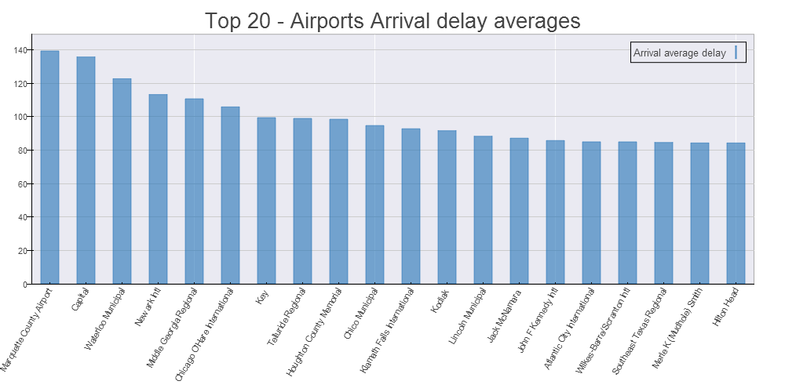
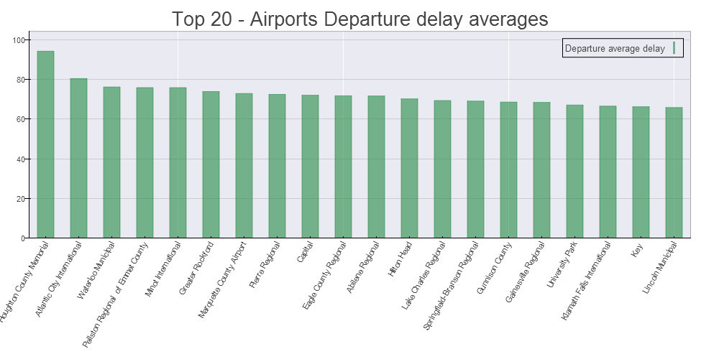
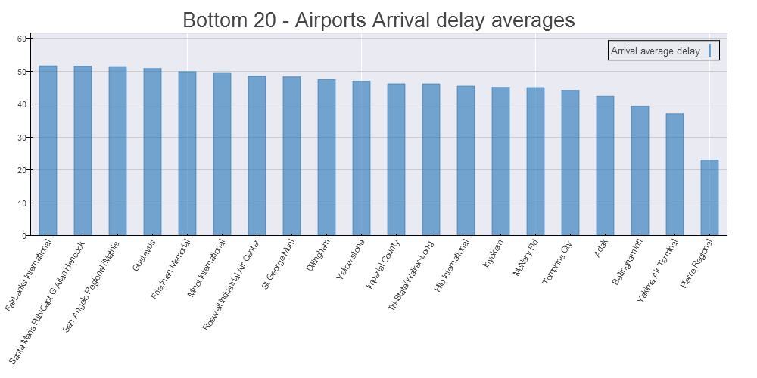
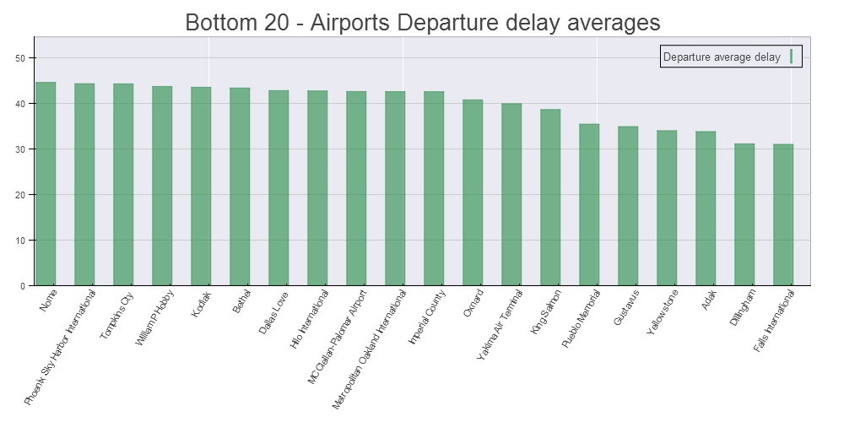
Delay Averages by Airport
Inferences -
The following airports seem to have the highest average delays. These airports are relatively smaller with lesser number of flights. Marquette County Airport has actually closed recently. Waterloo Municipal sees just one scheduled airline. 1) - Marquette County Airport, 2) – Capital, 3) Waterloo Municipal
The following airports seem to have the lowest amount of average delays. These airports are relatively smaller but seem to be better equipped with resources to co-ordinate the arrival and delay procedure. 1) - Fairbanks Intl , 2) – Capt. G Allen Hancock
This indicates that the airports which are around major hubs experience lesser average delays. Ironicaly most of the airports experiencing less average delays were actually army airports that were later converted to public airports.
Notes:
Graphs+Inferences

Slide 7
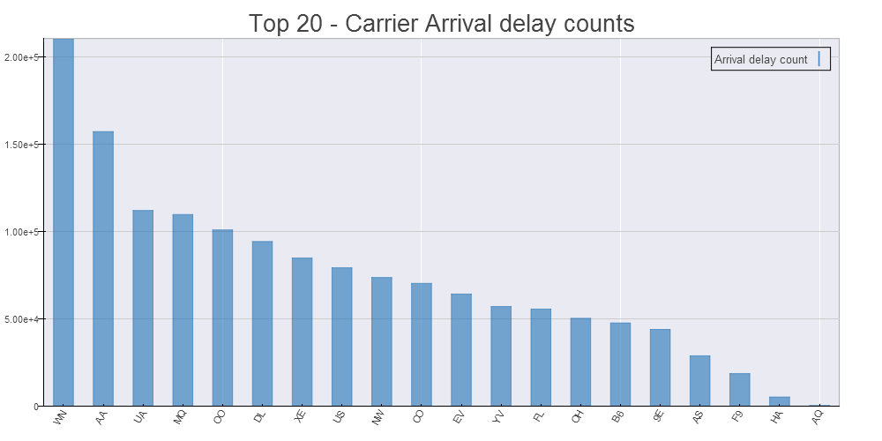
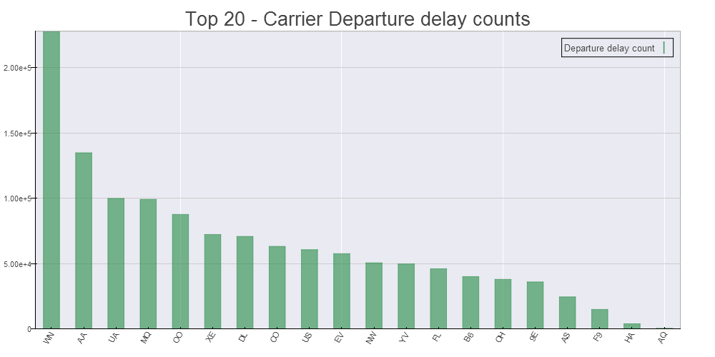
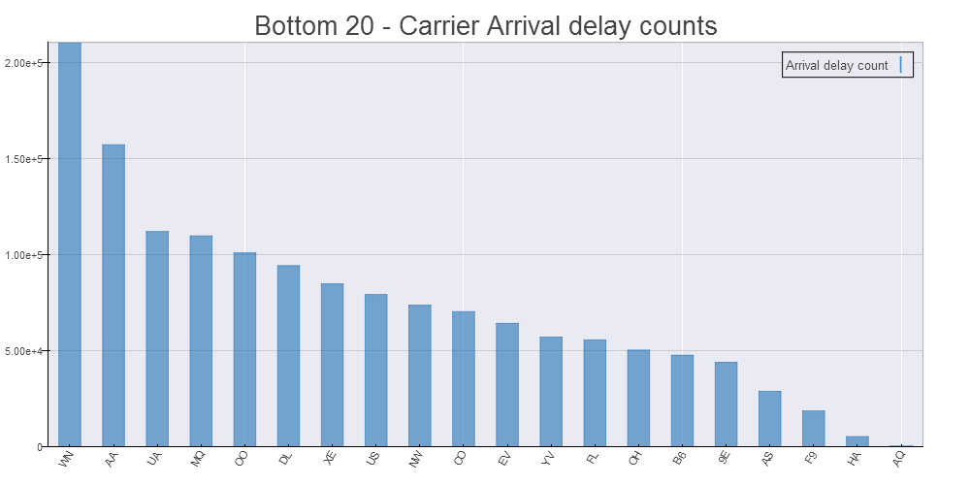
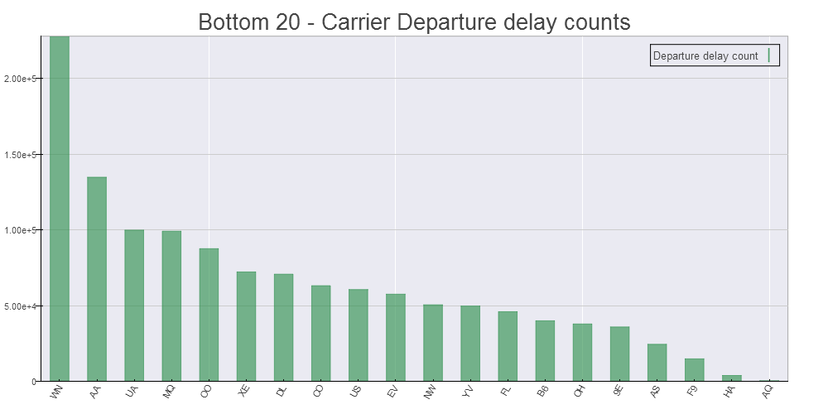
Delay Counts by Carrier
Here we analyze the delays by different airline carriers. It will be interesting to see if some airlines perform worst than others.
Inferences -
The following carriers seem to have to have the highest number of delays. 1) - Southwest Airlines 2) - American Airlines 3) - United Airlines
The following airports seem to have to have the lowest count of delayed flights. These carriers are relatively small catering to just specific regions and hence probably have lesser number of flights.
1) - Aloha Airlines 2) - Hawaiian Airlines 3) - Frontier Airlines
Notes:
Graphs+Inferences

Slide 8
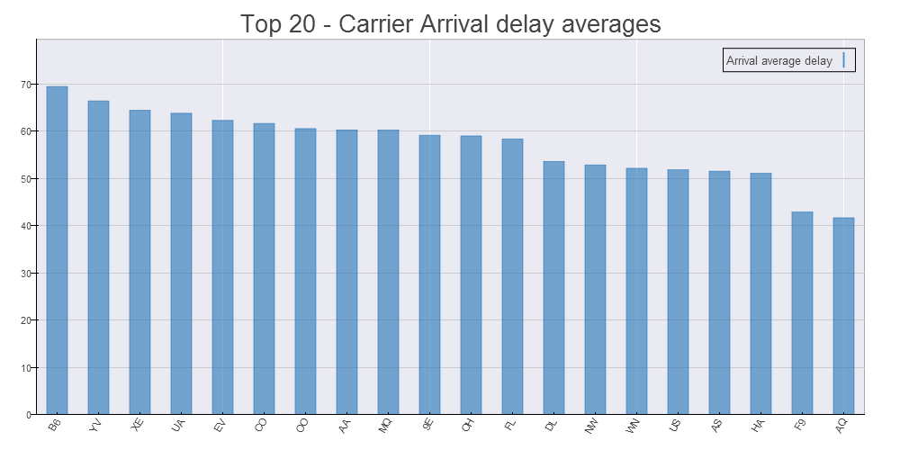
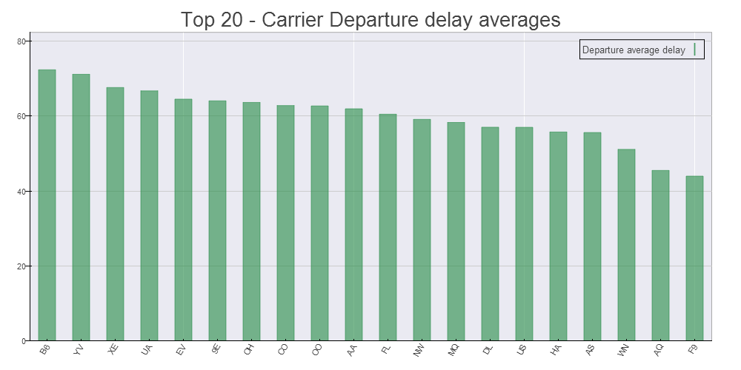
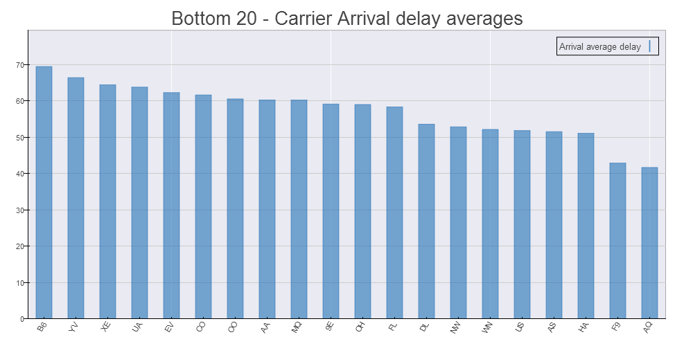
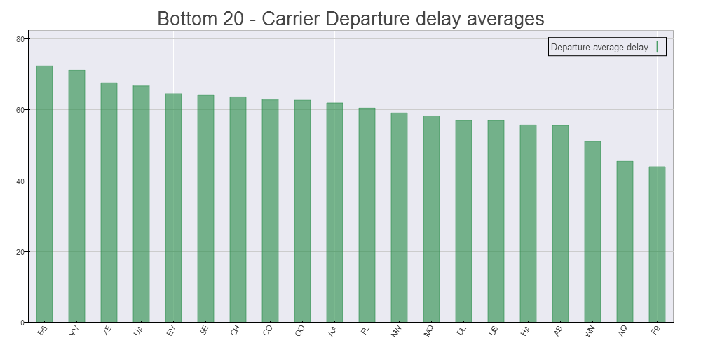
Delay Averages by Carrier
Inferences -
The following carriers have the highest average delays. 1) - JetBlue Airways 2) - Mesa Airlines 3) - ExpressJet Airlines
The following carriers have the lowest average delays. These airports are relatively smaller but seem to be better equipped with resources to co-ordinate the arrival and delay procedure. 1) - Aloha Airlines 2) - Frontier Airlines 3) - Hawaiian Airlines
These are the same airlines that had the lowest number of delayed flights. Lesser number of flights combined with operational excellence look like probable factors that affect the average delays for carriers (Ironically, two run between Hawaii and mainland US)
Notes:
Graphs+Inferences

Slide 9
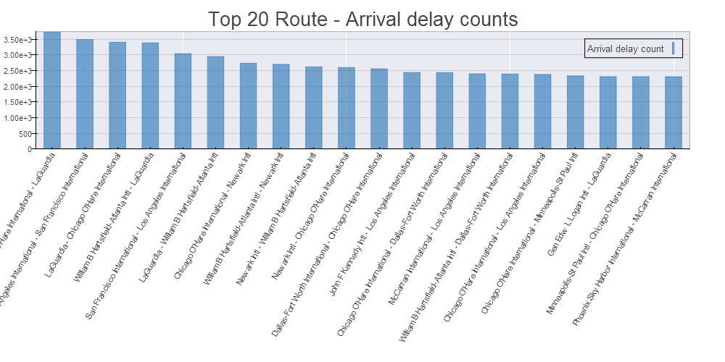
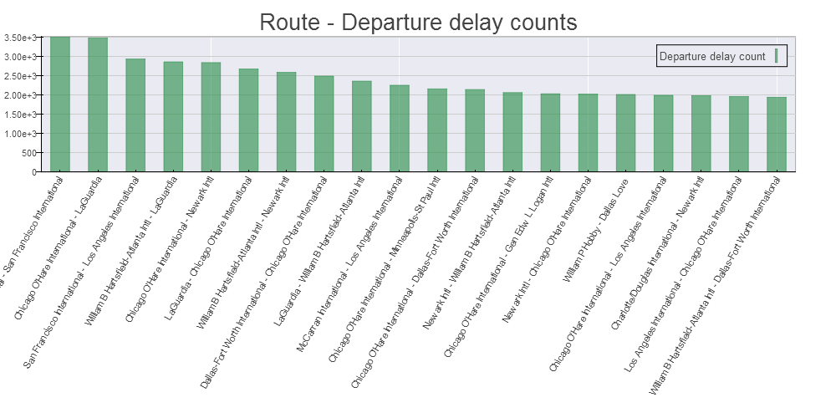
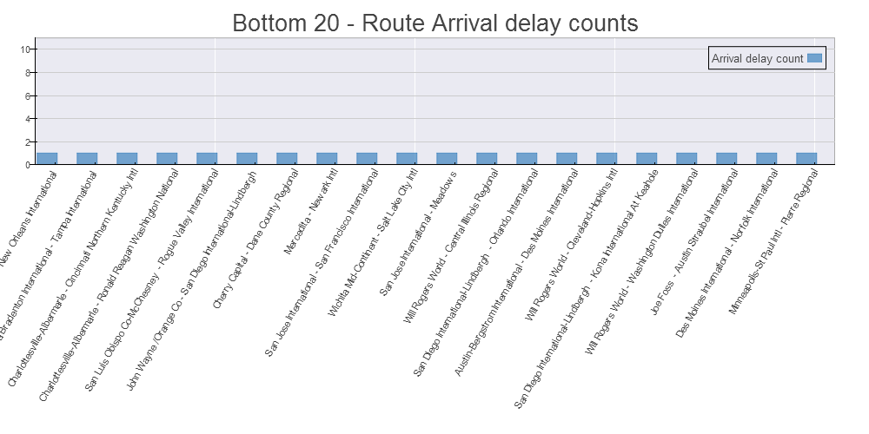
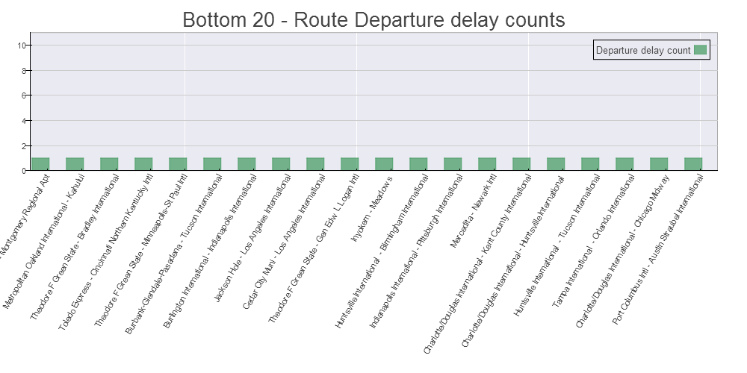
Delay Counts by Route
Inferences -
The following routes have the highest average delays. These routes connect major airports and hence the number of flights connecting these airports is also pretty high. It makes logical sense that they will also have the highest amount of delayed flights 1) - Chicago O'Hare - LaGuardia 2) - Los Angeles - San Francisco 3) - LaGuardia - Chicago O'Hare
The following airports seem to have the lowest amount of average delays. These airports are relatively smaller and hence the number of flights connecting them would be less as compared to the major hubs. 1) - Bradenton - Tampa 2) - Charlottesville - North Kentucky 3) - Charlottesville - Ronald Reagan Washington.
Notes:
Graphs+Inferences

Slide 10
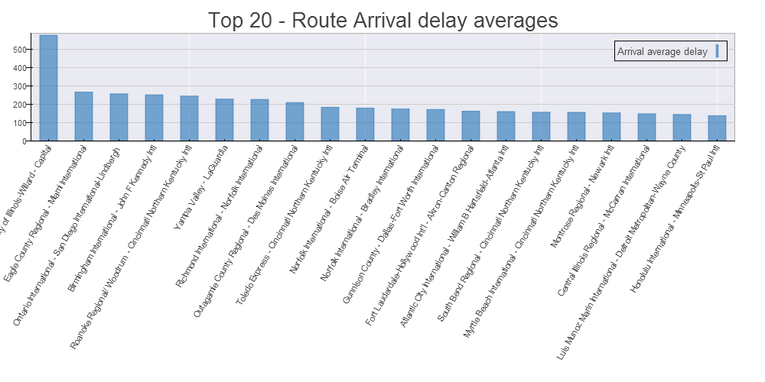
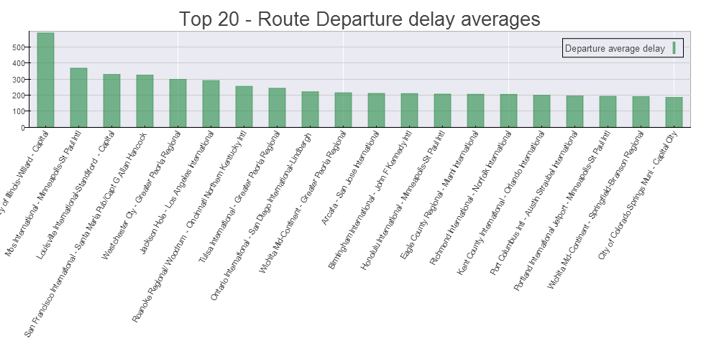
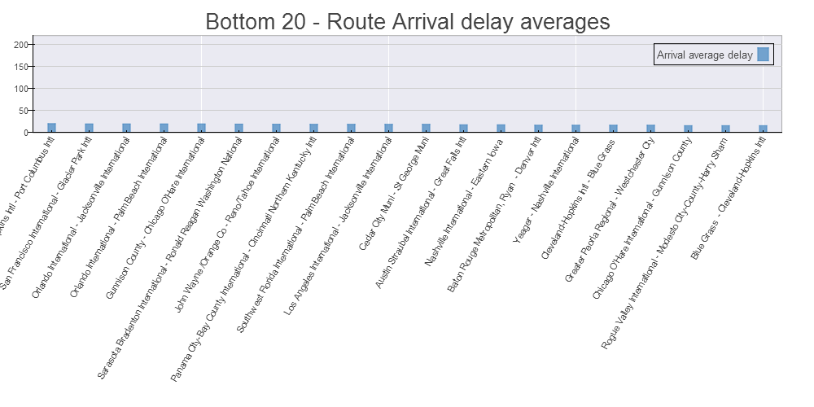
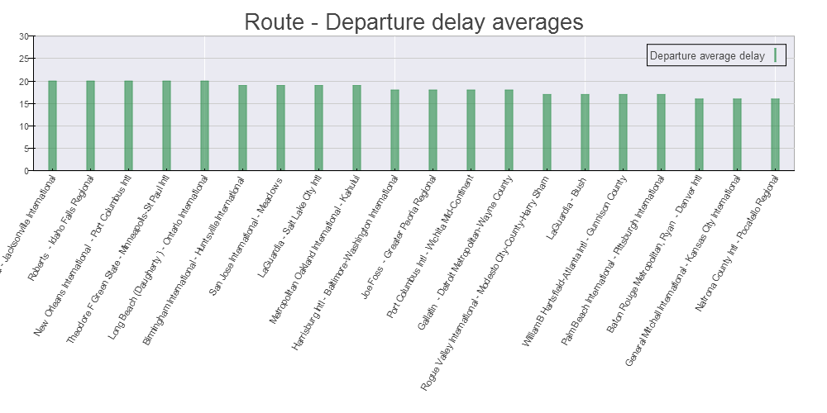
Delay Averages by Route
Inferences -
The following routes have the highest average delays. At least one airport, mostly the origin airport, seems to be a minor airport. The resources available to these airports seem to cause a bottleneck in flights. 1) - University of Illinois Willard Airport - Capital 2) - Eagle County Regional - Miami International 3) - Ontario International - San Diego
The following airports seem to have the lowest amount of average delays. These routes connect relatively small airports and hence the flight frequency would be a factor, but it itself would not be able to explain the observations. 1) - Roberts - Idaho Falls 2) - New Orleans - Port Columbus 3) - Theodore F Green - Minneapolis St Paul
Notes:
Graphs+Inferences

Slide 11
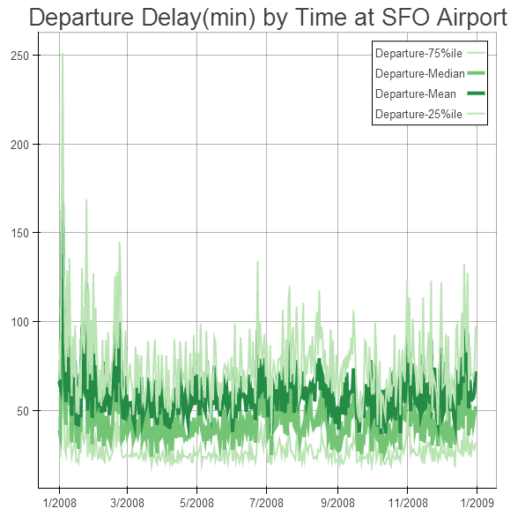
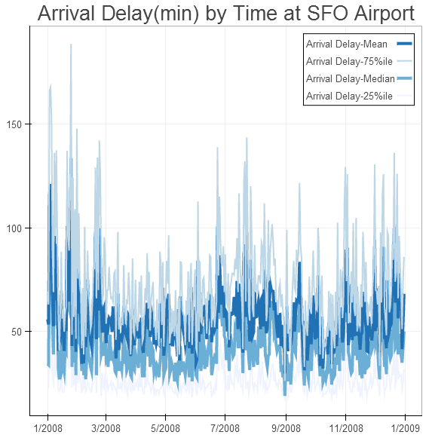
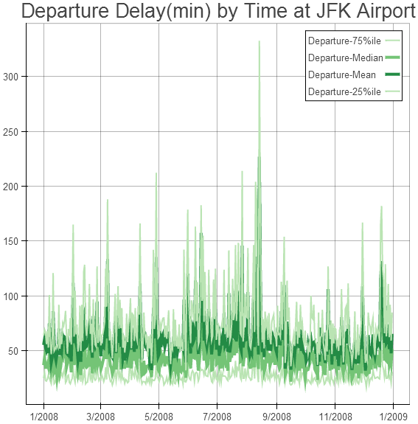
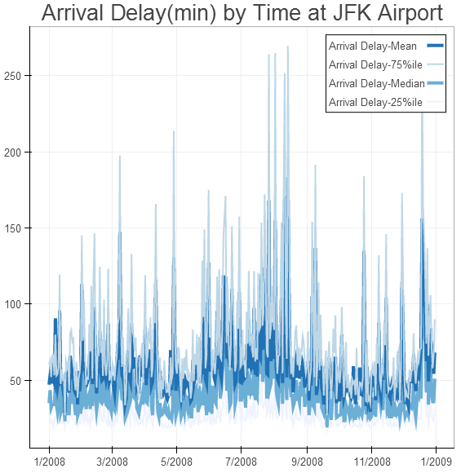
Delays by Time
Here we analyze the relationship between time of the year and delays.
See graphs on departure and arrival delays in minutes for JFK and SFO airport on the left.
Key Findings:
There is strong correlation between arrival and departure delays
The time of the year and delays have some correlation, but not a stronger one.
During holidays, we observed that average delay increases. Notice the increase at JFK and SFO airport delays around Christmas, Thanksgiving etc.
For the extreme peaks that we see in the graphs on the left, we found that the respective airports had runway maintenance that caused the delays.
Notes:
Graphs+Inferences

Slide 12
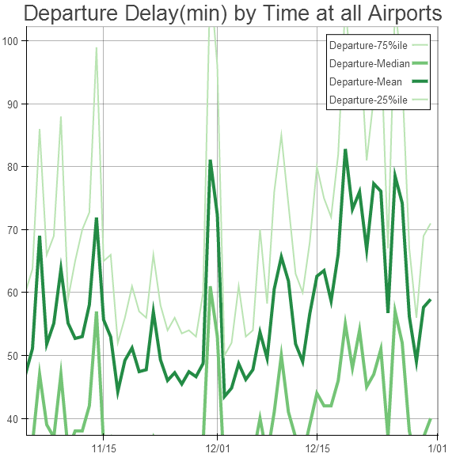
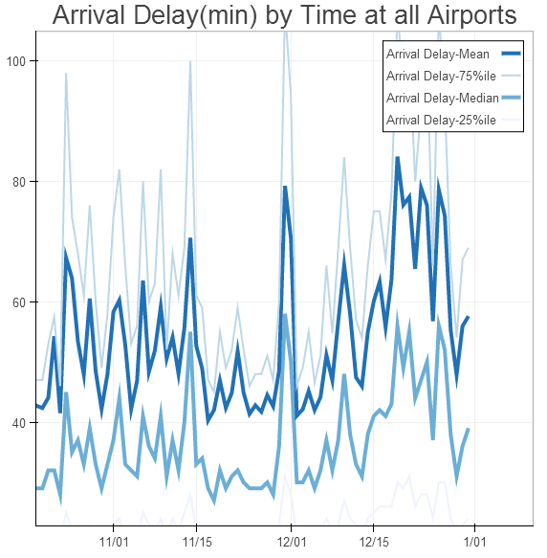
Delays by Time
Above graphs describe the average delays for departure and arrivals in minutes across all US airports. We observe that the delays increase around the holiday season. Notice the increasing trend post Thanksgiving. There is a sudden dip on 12/25 and 12/31, where people usually don’t travel.
Notes:
Graphs+Inferences

Slide 13
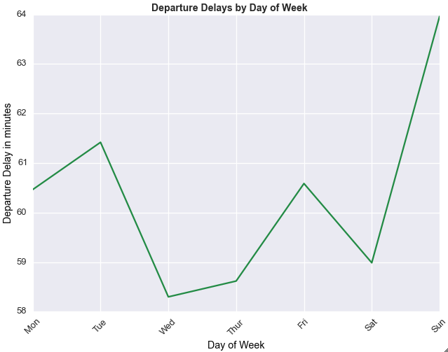
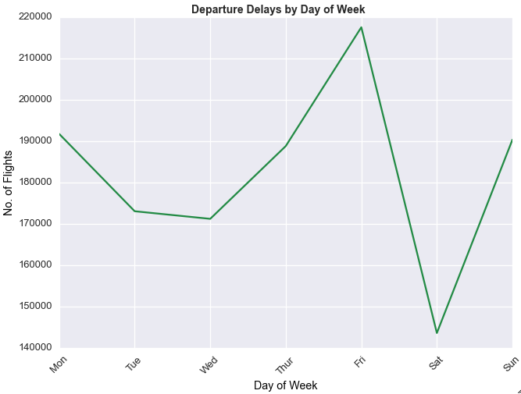
Delays by Day of week
Above graphs show the departure delays – no. of flights and time by day of week for 2008.
Key Findings:
Average departure delay in minutes was highest on Sunday, approx. 64mins across US in 2008, although the number of delayed flights is less
Friday has the highest number of delayed delays by departure
Wednesday is the best day to fly by looking at the overall average.
Thursday/Friday have more delayed flights than the rest of the week.
Notes:
Graphs+Inferences

Slide 14
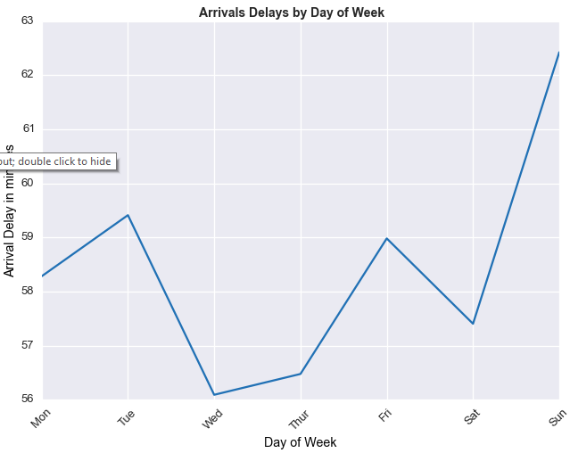
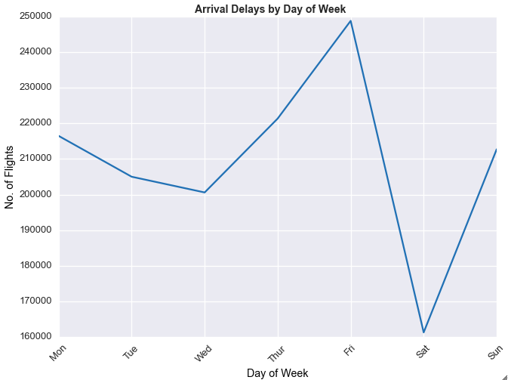
Delays by Day of week
Above graphs show the arrival delays – no. of flights and time by day of week for 2008. The trend is similar to departure delays.
Notes:
Graphs+Inferences

Slide 15
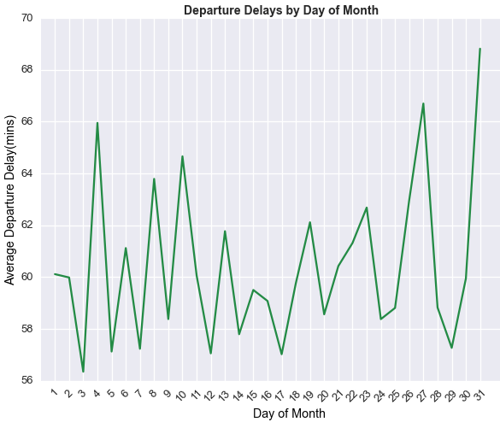
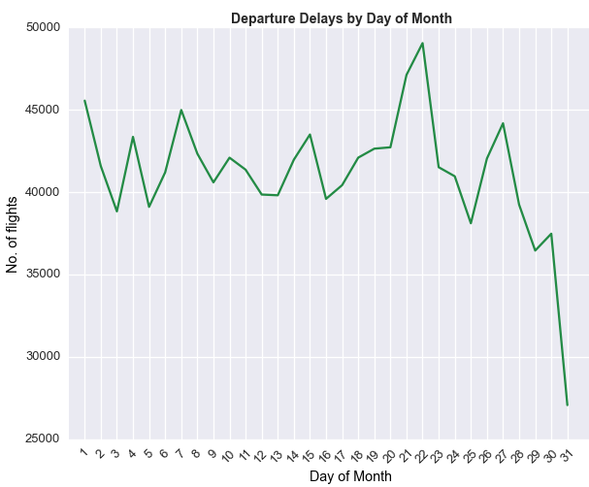
Delays by Day of Month
Above graphs show the departure delays – no. of flights and time by day of month for 2008 across all US airports.
Key Findings:
We notice that more flights were delayed in the fourth week of the month than the other.
On an average, day of month and delays don’t have a strong correlation.
In the middle of the month, the average delay in minutes and total number of delayed flights is lower compared to initial and last weeks.
Notes:
Graphs+Inferences

Slide 16
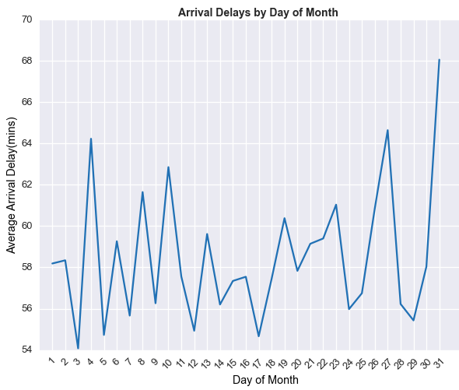
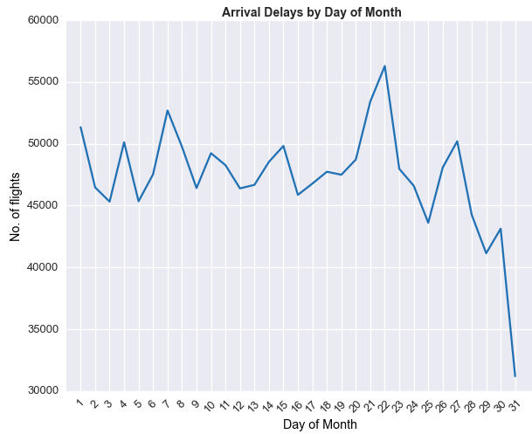
Delays by Day of Month
Above graphs show the arrival delays – no. of flights and time by day of month for 2008. The trend is similar to Departure delays.
Notes:
Graphs+Inferences

Slide 17
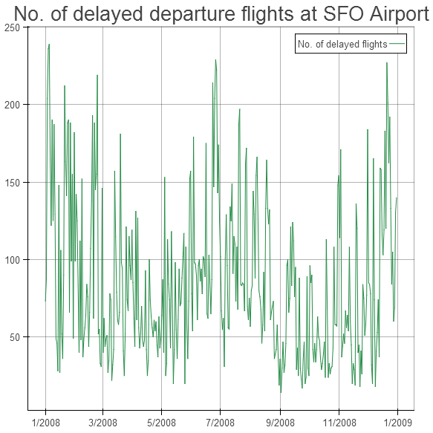
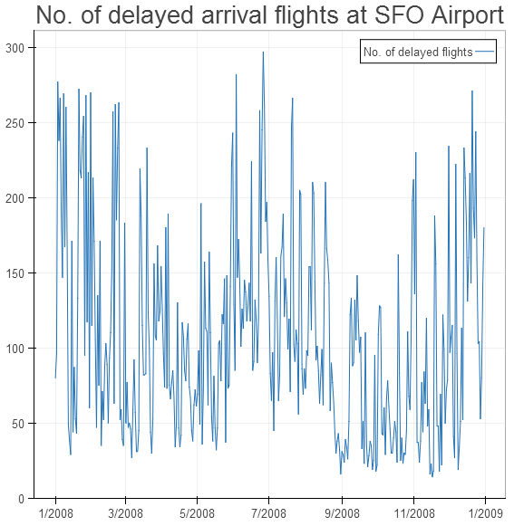
SFO Airport
Visualizing delays at SFO airport across 2008
Notes:
Graphs+Inferences

Slide 18
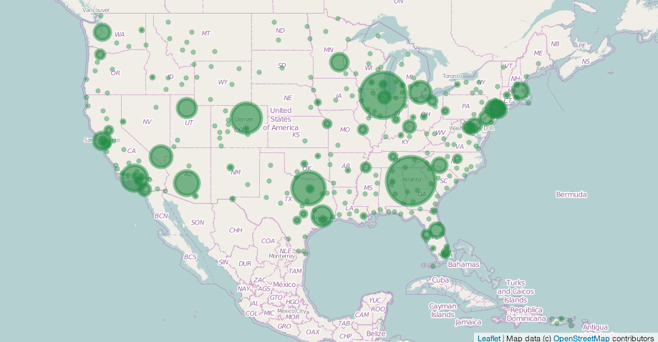
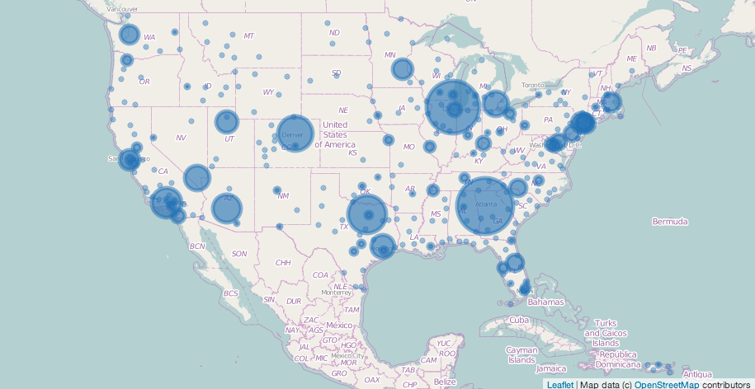
Busiest Airports by Departure and Arrival
Notes:
There is not much of a difference in business between arrivals and departures.
The busiest airports by departure and arrival are the same:
William B Hartsfield- Atlanta Intl, Atlanta
Chicago O’Hare International, Chicago
Dallas-Fort Worth International, Dallas-Fort
Denver Intl, Denver
Los Angeles International, Los Angeles
The top 5 least busy airports by departure :
Bemidji-Beltrami County, Bemidji
Falls International, International Falls
Tupelo Municipal, Tupelo
Pierre Regional, Pierre
Pueblo Memorial, Pueblo
The top 5 least busy airports by arrivals :
1. Falls International, International Falls
2. Tupelo Municipal, Tupelo
3. Pierre Regional, Pierre
4. Cheyenne, Cheyenne
5. Ogden-Hinckley, Ogden

Slide 19
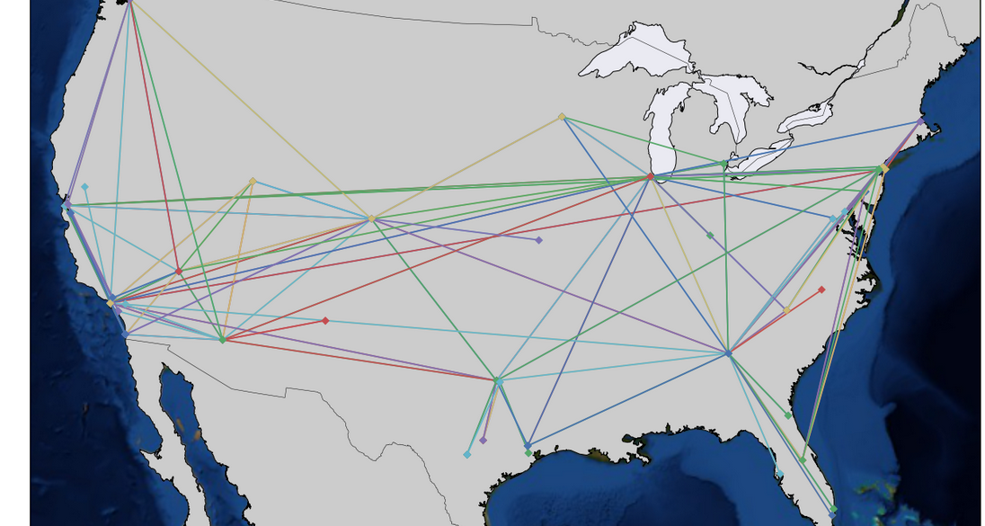
Airline Route Density
Notes:
We have defined route density as the number of flights flying between two airports in the given year. This visualization shows all possible routes in the US traversed by in 2008. It shows how well connected the cities are.

Slide 20
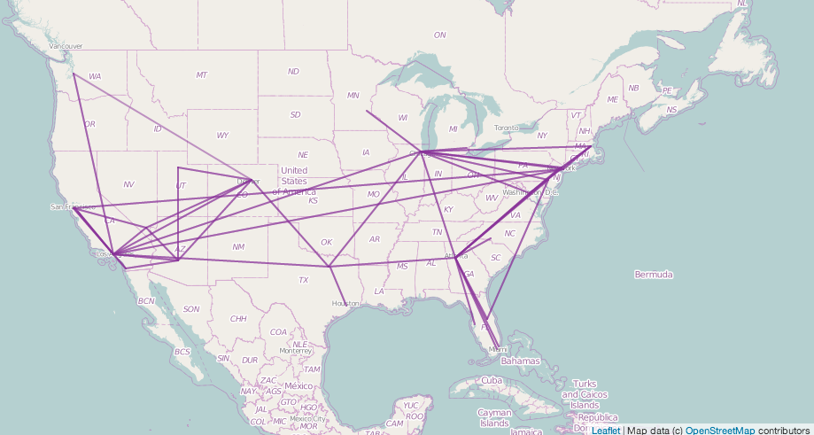
Top Airline Routes
Notes:
This map shows the top 100 most frequently traveled routes in the US. As you can see, there are a lot of flights originating from Chicago and LA and Atlanta.

Slide 21
Future work
Scaling our analysis to all the datasets
Implement user interactivity by introducing fields, buttons and controls
Analyze causes for delays and cancellations
Visualize routes of popular carriers

Slide 22
Steps for reproducing the notebook
Get the data from the sources - http://stat-computing.org/dataexpo/2009/the-data.html. Additionally, also download the supplemental data sets - airports, carriers, plane-data found at http://stat-computing.org/dataexpo/2009/supplemental-data.html.
Initialize the constants described in begining of the file - INPUT_FILE_PATH
Install the required python libraries - pandas, numpy, bokeh, seaborn, folium, basemap, pyplot, matplotlib, csv, os. Additionally for folium, follow the commands - "pip uninstall folium" and then - "pip install git+git://github.com/wrobstory/folium.git”
Run the notebook

Slide 23



